Slide 1
Finance
Introduction

Slide 2
What We Will Cover
Macroeconomics and Microeconomics
What is Finance?
Theory of the Operation of Monetary Policy
Typical Accounting Forms
Financial Instruments Compared to Money
The Financial Services Industry
U.S. Economy
Markets and Their Operations
How an Investment Bank is Organized
A Typical Investment Bank Trade
Derivative Products
The Trade Life Cycle
Major Players – and others
Straight Through Processing
Concurrent Processes

Slide 3
What is Finance?
The science of the management of money and other assets. (Free Dictionary)
Finance is the application of economic principles to decision-making that involves the allocation of money under conditions of uncertainty. (http://techbus.safaribooksonline.com/book/finance-accounting/9780470609712)

Slide 4
Finance
So what is Money?

Slide 5
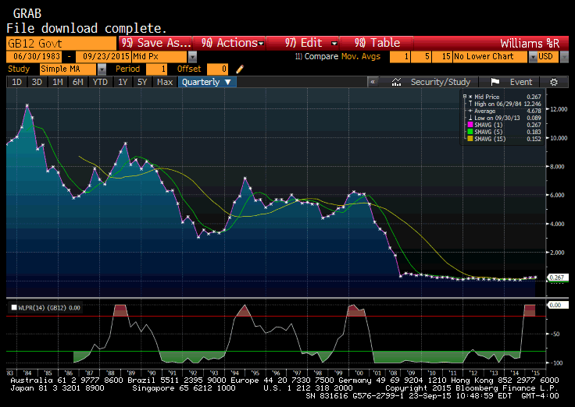
Inflation/Disinflation Chart

Slide 6
Finance
What makes up Finance?

Slide 7

Three Areas Within the Field of Finance
Investment Management
Capital Markets and Capital Market Theory
Financial management

Slide 8
Capital Markets and Capital Market Theory
The field of capital markets and capital market theory focuses on the study of the financial system, the structure of interest rates, and the pricing of risky assets. The financial system of an economy consists of three components:
  (1) financial markets;
  (2) financial intermediaries; and
  (3) financial regulators

Slide 9
Financial Management
Financial management, sometimes called business finance or corporate finance, is the specialty area of finance concerned with financial decision-making within a business entity.
Another critical task in financial management is the risk management of a company. The process of risk management involves determining which risks to accept, which to neutralize, and which to transfer.

Slide 10
Investment Management
Investment management is the specialty area within finance dealing with the management of individual (high net worth) or institutional funds (capital markets).
Setting investment objectives starts with a thorough analysis of what the entity or client wants to accomplish.

Slide 11
USA Economy
The US economy is a mixed economy including
a strong private sector of companies and organizations which operate for profit and a public sector providing essential services such as emergency healthcare and education.
The USA economy is an open economy which means the value of its currency fluctuates and there are no restrictions on the movement of goods and currency.

Slide 12
USA Economy – Economic Indicators
Inflation
  Amount of money increases at a greater rate than the supply of goods
  Result higher prices
  Savings worth less
  Federal Reserve attempts to control by raising interest rates
Indicators
  Consumer Price Index (CPI) – The official measure of inflation

Slide 13
USA Economy – Economic Indicators
Inflation Rate – based on CPI
Gross Domestic Product (GDP) = value of all goods and services produced within the country
- Balance of Payments = Exports - Imports
Unemployment Rate
USA budget deficit = Amount required for all public sector activities – Amount collected from taxation and other sources
Interest Rate – cost of borrowing (tightening/loosening credit)
Dow Jones– indicates the average share price for 30 companies traded in the USA

Slide 14
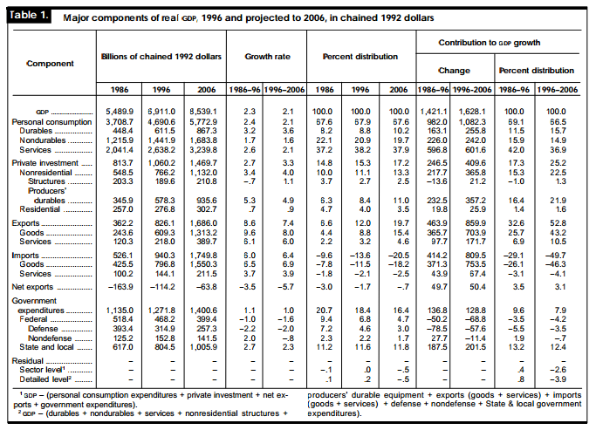

Slide 15
US Economy – Exercise 10 minutes
Find out the current US values of:-
Inflation, Unemployment, Official Interest Rate
Compare USA inflation and unemployment rates with Canada, France, Germany and UK. Also find the name of each country's central bank.

Slide 16
Balance Sheet
 | MATTEL, INC. (MAT) | Balance Sheet
 | Period Ending | Dec 31, 2014 |  | Liabilities
 |  |  |  | Current Liabilities
 | Assets |  |  | -Accounts Payable | 1,088,949
 | Current Assets |  |  | -Short/Current Long Term Debt | -
 | - Cash And Cash Equivalents | 971,650 |  | -Other Current Liabilities | -
 | - Short Term Investments | -
 | - Accounts Receivable | 1,093,180 |  | Total Current Liabilities | 1,088,949
 | - Inventory | 562,047
 | - Other Current Assets | 559,074 |  | Long Term Liabilities
 | - Prepaid Expenses | 0 |  | Long Term Debt | 2,100,000
 | Total Current Assets | 3,185,951 |  | Other Liabilities | 584,026
 | Long Term Investments | - |  | Total Liabilities | 3,772,975
 | Property Plant and Equipment | 737,869
 | (Less Accumulated Depreciation) |  |  | Stockholders' Equity
 | Accounts Payable | 0 |  | Misc Stocks Options Warrants | -
 | Goodwill | 1,393,968 |  | Redeemable Preferred Stock | -
 | Intangible Assets | - |  | Preferred Stock | -
 | Accumulated Amortization | - |  | Common Stock | 441,369
 | Other Assets | 1,404,258 |  | Retained Earnings | 3,896,261
 | Deferred Long Term Asset Charges | - |  | Treasury Stock | -2,533,566
 | Total Assets | 6,722,046 |  | Capital Surplus | 1,767,096
 |  |  |  | Other Stockholder Equity | -622,089
 |  |  |  | Total Stockholder Equity | 2,949,071
 | All numbers in thousands
 |  |  |  | Net Tangible Assets | 1,555,103
 |  |  |  | (also Book Value)

Slide 17
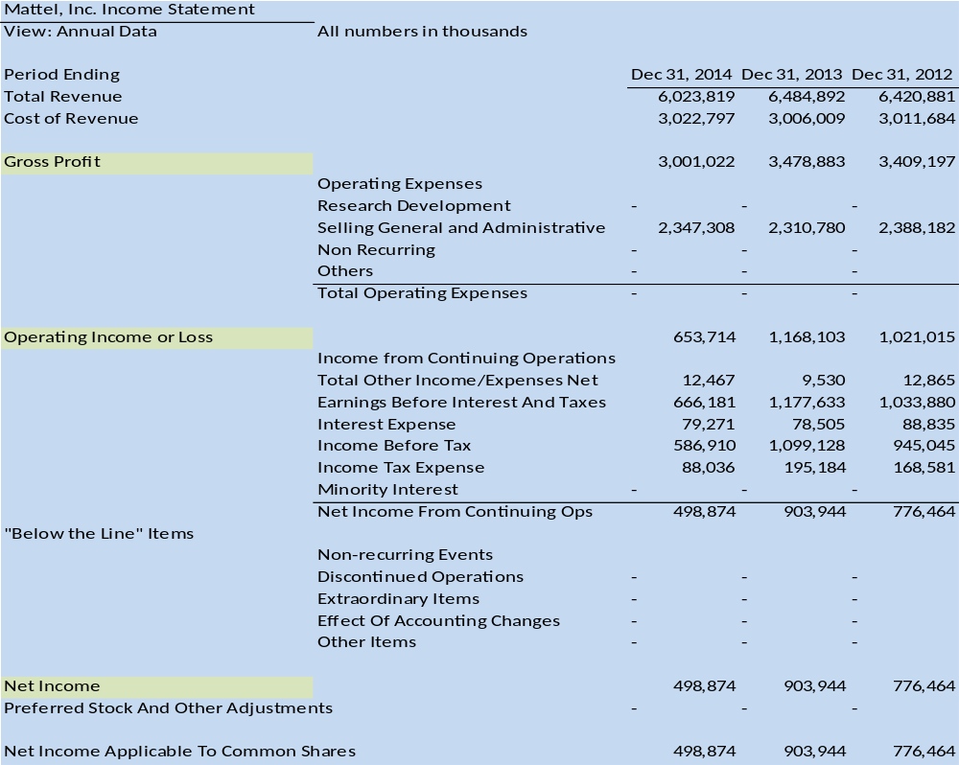
Mattel (MAT) Income Statement
Mattel, Inc. Income Statement
View: Annual Data | All numbers in thousands
Period Ending |  | Dec 31, 2014 | Dec 31, 2013 | Dec 31, 2012
Total Revenue |  | 6,023,819 | 6,484,892 | 6,420,881
Cost of Revenue |  | 3,022,797 | 3,006,009 | 3,011,684
Gross Profit |  | 3,001,022 | 3,478,883 | 3,409,197
 | Operating Expenses
 | Research Development | - | - | -
 | Selling General and Administrative | 2,347,308 | 2,310,780 | 2,388,182
 | Non Recurring | - | - | -
 | Others | - | - | -
 | Total Operating Expenses | - | - | -
Operating Income or Loss |  | 653,714 | 1,168,103 | 1,021,015
 | Income from Continuing Operations
 | Total Other Income/Expenses Net | 12,467 | 9,530 | 12,865
 | Earnings Before Interest And Taxes | 666,181 | 1,177,633 | 1,033,880
 | Interest Expense | 79,271 | 78,505 | 88,835
 | Income Before Tax | 586,910 | 1,099,128 | 945,045
 | Income Tax Expense | 88,036 | 195,184 | 168,581
 | Minority Interest | - | - | -
 | Net Income From Continuing Ops | 498,874 | 903,944 | 776,464
 | Non-recurring Events
 | Discontinued Operations | - | - | -
 | Extraordinary Items | - | - | -
 | Effect Of Accounting Changes | - | - | -
 | Other Items | - | - | -
Net Income |  | 498,874 | 903,944 | 776,464
Preferred Stock And Other Adjustments |  | - | - | -
Net Income Applicable To Common Shares |  | 498,874 | 903,944 | 776,464

Slide 18
Cash Flow Statement
Mattel (MAT) Cash Flow
Period Ending | Dec 31, 2014 | Dec 31, 2013 | Dec 31, 2012
Net Income | 498,874 | 903,944 | 776,464
Operating Activities, Cash Flows Provided By or Used In
Depreciation | 248,701 | 196,393 | 174,282
Adjustments To Net Income | 38,948 | 44,909 | -8,704
Changes In Accounts Receivables | 90,285 | -48,802 | 66,999
Changes In Liabilities | -34,653 | -201,868 | 312,634
Changes In Inventories | 43,392 | -116,509 | 34,382
Changes In Other Operating Activities | 3,017 | -79,641 | -80,407
Total Cash Flow From Operating Activities | 888,564 | 698,426 | 1,275,650
Investing Activities, Cash Flows Provided By or Used In
Capital Expenditures | -260,457 | -252,054 | -219,048
Investments | -19,933 | 12,849 | 2,964
Other Cash flows from Investing Activities | -428,162 | -2,901 | -684,068
Total Cash Flows From Investing Activities | -708,552 | -242,106 | -900,152
Financing Activities, Cash Flows Provided By or Used In
Dividends Paid | -514,813 | -494,371 | -423,378
Sale Purchase of Stock | -133,863 | -358,234 | 55,563
Net Borrowings | 446,594 | 85,691 | -48,174
Other Cash Flows from Financing Activities | -46,424 | -23,422 | -30,737
Total Cash Flows From Financing Activities | -227,319 | -739,962 | -410,928
Effect Of Exchange Rate Changes | -20,259 | -12,853 | 2,028
Change In Cash and Cash Equivalents | -67,566 | -296,495 | -33,402
All numbers in thousands

Slide 19
Financial Reporting Ratios
Liquidity
Current ratio--current assets divided by current liabilities
Net working capital ratio--current assets minus current liabilities, then divided by total assets.
These ratios indicate a company's ability to pay its bills on time. Also discuss significant changes: For example, the company may have recently paid cash--a current asset--to buy new equipment, thus reducing the current ratio.
Debt
Debt-to-equity ratio--total liabilities divided by total equity
Interest coverage ratio--earnings before interest and taxes divided by interest expenses
Profitability
- profit margin--net income divided by sales
- return on equity--net income divided by shareholders' equity
- The profit margin ratio shows how much of each sales dollar flows to the bottom line. The return on equity ratio shows how efficiently management has deployed shareholder funds.

Slide 20
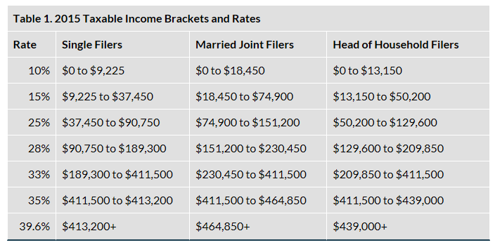
Tax Brackets 2015

Slide 21
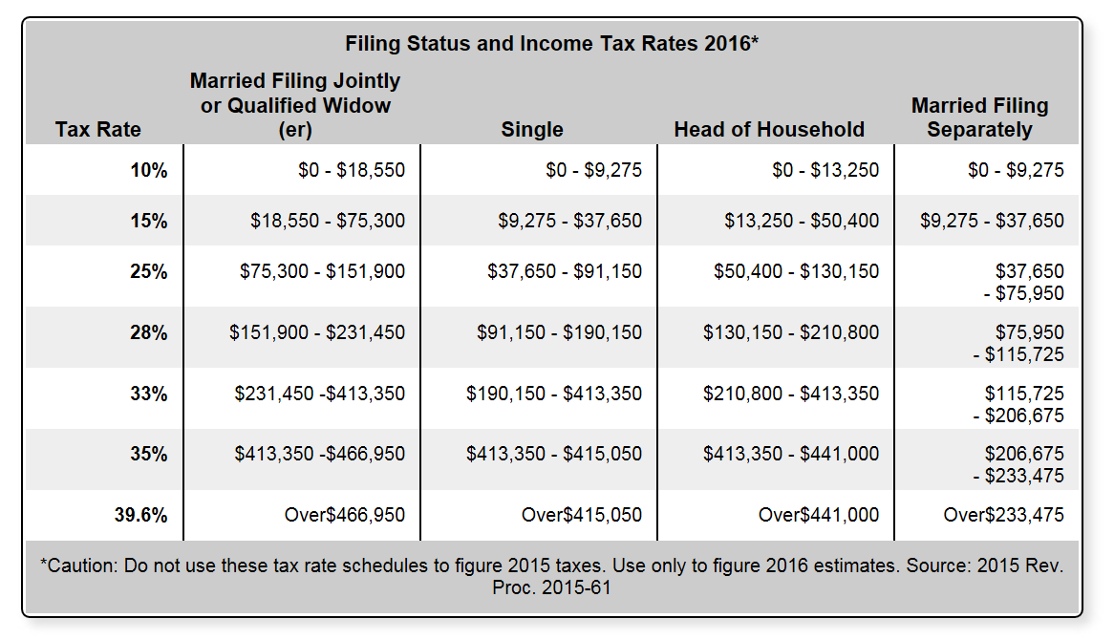
Tax Brackets 2016

Slide 22
Bond Trading
<
Bond Premium
>
Current Yield Rate
Par

